Slide 1


Lecture 11:
Regular Expressions
CoTaPP: Computational Thinking and
Programming with Python
All icons by: https://www.flaticon.com/

Slide 2

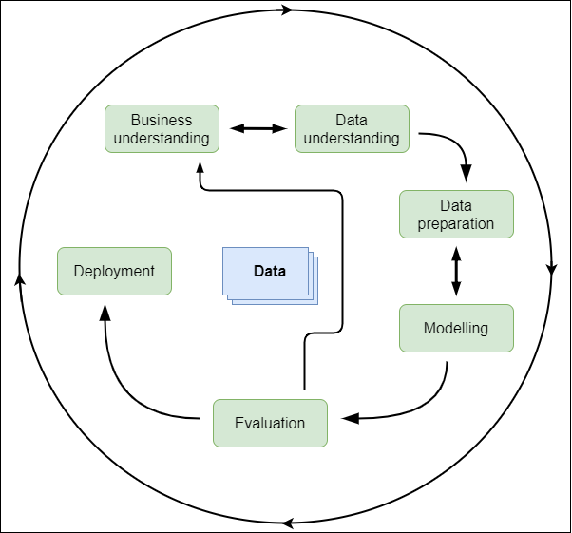
Previous lecture

Slide 3

Previous lecture

Slide 4

Previous lecture

Slide 5

Previous lecture

Slide 6

Today: Regular Expressions

Slide 7
Case study: Anonymization
Patient: Mary Johnson
Address: Merelstraat 32, 4005EX Tiel
Mrs has slept badly, slept from
1:00 until 4:00. Came then from
bed, ate cookies and drank tea.
Still advised to take medication
and voiced my concern about
evt. conversion in mania. Mrs
was not happy about it and
reacted agitated.

Slide 8
Case study: Anonymization
Patient: Mary Johnson
Address: Merelstraat 32, 4005EX Tiel
Mrs has slept badly, slept from
1:00 until 4:00. Came then from
bed, ate cookies and drank tea.
Still advised to take medication
and voiced my concern about
evt. conversion in mania. Mrs
was not happy about it and
reacted agitated.

Slide 9
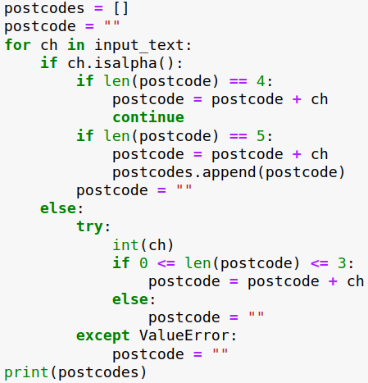
Case study: Anonymization
Patient: Mary Johnson
Address: Merelstraat 32, 4005EX Tiel
Mrs has slept badly, slept from
1:00 until 4:00. Came then from
bed, ate cookies and drank tea.
Still advised to take medication
and voiced my concern about
evt. conversion in mania. Mrs
was not happy about it and
reacted agitated.

Slide 10

Case study: Anonymization
Patient: Mary Johnson
Address: Merelstraat 32, 4005EX Tiel
Mrs has slept badly, slept from
1:00 until 4:00. Came then from
bed, ate cookies and drank tea.
Still advised to take medication
and voiced my concern about
evt. conversion in mania. Mrs
was not happy about it and
reacted agitated.

Slide 11
Case study: Anonymization
Patient: Mary Johnson
Address: Merelstraat 32, 34005EX Tiel
Mrs has slept badly, slept from
1:00 until 4:00. Came then from
bed, ate cookies and drank tea.
Still advised to take medication
and voiced my concern about
evt. conversion in mania. Mrs
was not happy about it and
reacted agitated.

Slide 12
Case study: Anonymization
Patient: Mary Johnson
Address: Merelstraat 32, 4005 EX Tiel
Mrs has slept badly, slept from
1:00 until 4:00. Came then from
bed, ate cookies and drank tea.
Still advised to take medication
and voiced my concern about
evt. conversion in mania. Mrs
was not happy about it and
reacted agitated.

Slide 13
Solution: Patterns
Patient: Mary Johnson
Address: Merelstraat 32, 4005 EX Tiel
Mrs has slept badly, slept from
1:00 until 4:00. Came then from
bed, ate cookies and drank tea.
Still advised to take medication
and voiced my concern about
evt. conversion in mania. Mrs
was not happy about it and
reacted agitated.
FUNCTION
4005 EX
####( )@@

Slide 14
Solution: Patterns
Patient: Mary Johnson
Address: Merelstraat 32, 4005EX Tiel
Mrs has slept badly, slept from
1:00 until 4:00. Came then from
bed, ate cookies and drank tea.
Still advised to take medication
and voiced my concern about
evt. conversion in mania. Mrs
was not happy about it and
reacted agitated.
FUNCTION
4005EX
####( )@@

Slide 15
Solution: Patterns
Patient: Mary Johnson
Address: Merelstraat 32, 34005 EX Tiel
Mrs has slept badly, slept from
1:00 until 4:00. Came then from
bed, ate cookies and drank tea.
Still advised to take medication
and voiced my concern about
evt. conversion in mania. Mrs
was not happy about it and
reacted agitated.
FUNCTION
####( )@@

Slide 16
Regular Expressions
(([\w-]+(?:\.[\w-]+)*)@((?:[\w-]+\.)*\w[\w-]{0,66})\.([a-z]{2,6}(?:\.[a-z]{2})?))(?![^<]*>)

Slide 17
Regular Expressions
(([\w-]+(?:\.[\w-]+)*)@((?:[\w-]+\.)*\w[\w-]{0,66})\.([a-z]{2,6}(?:\.[a-z]{2})?))(?![^<]*>)
Patient: Mary Johnson
Address: Merelstraat 32, 4005 EX Tiel
Mrs has slept badly, slept from
1:00 until 4:00. Came then from
bed, ate cookies and drank tea.
Still advised to take medication
and voiced my concern about
evt. conversion in mania. Mrs
was not happy about it and
reacted agitated.

Slide 18
Regular Expressions
(([\w-]+(?:\.[\w-]+)*)@((?:[\w-]+\.)*\w[\w-]{0,66})\.([a-z]{2,6}(?:\.[a-z]{2})?))(?![^<]*>)
Patient: Mary Johnson
Address: Merelstraat 32, 4005 EX Tiel
Mrs has slept badly, slept from
1:00 until 4:00. Came then from
bed, ate cookies and drank tea.
Still advised to take medication
and voiced my concern about
evt. conversion in mania. Mrs
was not happy about it and
reacted agitated.

Slide 19
Regular Expressions
(([\w-]+(?:\.[\w-]+)*)@((?:[\w-]+\.)*\w[\w-]{0,66})\.([a-z]{2,6}(?:\.[a-z]{2})?))(?![^<]*>)
Patient: Mary Johnson
Address: Merelstraat 32, 4005 EX Tiel
Mrs has slept badly, slept from
1:00 until 4:00. Came then from
bed, ate cookies and drank tea.
Still advised to take medication
and voiced my concern about
evt. conversion in mania. Mrs
was not happy about it and
reacted agitated.

Slide 20
Literals
“e”, “22”, “. l”

Slide 21
Literals
“e”, “22”, “ l”
Today is my 22nd birthday. I am really happy.
Pattern | Match
e | Today is my 22nd birthday. I am really happy.
22 | Today is my 22nd birthday. I am really happy.
. I | Today is my 22nd birthday._I am really happy.

Slide 22
Literals
“e”, “22”, “ l”
Today is my 22nd birthday. I am really happy.
Pattern | Match
e | Today is my 22nd birthday. I am really happy.
22 | Today is my 22nd birthday. I am really happy.
. I | Today is my 22nd birthday._I am really happy.
# Find “e”
text = “Today is my 22nd birthday. I am really happy.”
text.find(“e”)

Slide 23
Character Classes
[23], [rt]
Today is my 22nd birthday. I am really happy.
Pattern | Match
[23] | Today is my 22nd birthday. I am really happy.
[rt] | Today is my 22nd birthday. I am really happy.

Slide 24
Character Classes
Today is my 22nd birthday. I am really happy.
Pattern | Match
[23] | Today is my 22nd birthday. I am really happy.
[rt] | Today is my 22nd birthday. I am really happy.
[a-c] | Today is my 22nd birthday. I am really happy.

Slide 25
Character Classes
Today is my 22nd birthday. I am really happy.
Pattern | Match
[23] | Today is my 22nd birthday. I am really happy.
[rt] | Today is my 22nd birthday. I am really happy.
[a-c] | Today is my 22nd birthday. I am really happy.
2[0-9] | Today is my 22nd birthday. I am really happy.

Slide 26

Character Classes
Today is my 22nd birthday. I am really happy.
Pattern | Match
[23] | Today is my 22nd birthday. I am really happy.
[rt] | Today is my 22nd birthday. I am really happy.
[a-c] | Today is my 22nd birthday. I am really happy.
2[0-9] | Today is my 22nd birthday. I am really happy.
[5-9][0-9]

Slide 27
Character Classes
Today is my 22nd birthday. I am really happy.
Pattern | Match
[23] | Today is my 22nd birthday. I am really happy.
[rt] | Today is my 22nd birthday. I am really happy.
[a-c] | Today is my 22nd birthday. I am really happy.
2[0-9] | Today is my 22nd birthday. I am really happy.
[5-9][0-9] | No matches. This pattern matches 50 thru 99

Slide 28
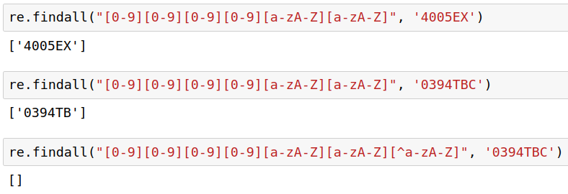
Negation
Patient: Mary Johnson
Address: Merelstraat 32, 4005EX Tiel
Mrs has slept badly, slept from
1:00 until 4:00. Came then from
bed, ate cookies and drank tea.
Still advised to take medication
and voiced my concern about
evt. conversion in mania. Mrs
was not happy about it and
reacted agitated.
This is another text containing no postcodes. It does mention some medication called 0394TBC

Slide 29
Negation
Patient: Mary Johnson
Address: Merelstraat 32, 4005EX Tiel
Mrs has slept badly, slept from
1:00 until 4:00. Came then from
bed, ate cookies and drank tea.
Still advised to take medication
and voiced my concern about
evt. conversion in mania. Mrs
was not happy about it and
reacted agitated.
This is another text containing no postcodes. It does mention some medication called 0394TBC
[^a-zA-Z]

Slide 30
Python shorthands
[0-9] → \d
[0-9a-zA-Z_] → \w
More in notebook

Slide 31
Boundary matchers
\b → word boundary
More in notebook

Slide 32
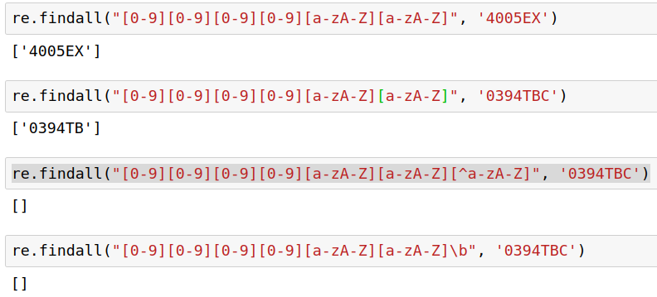
Boundary matchers
\b → word boundary
Patient: Mary Johnson
Address: Merelstraat 32, 4005EX Tiel
Mrs has slept badly, slept from
1:00 until 4:00. Came then from
bed, ate cookies and drank tea.
Still advised to take medication
and voiced my concern about
evt. conversion in mania. Mrs
was not happy about it and
reacted agitated.
This is another text containing no postcodes. It does mention some medication called 0394TBC

Slide 33
Repetition qualifiers
Qualifier | Number | Example | Result
? | 0 or 1 | [\d\d\d\d] ?[a-zA-Z][a-zA-Z] | Matches 4005EX as well as 4005 EX

Slide 34
Repetition qualifiers
Qualifier | Number | Example | Result
? | 0 or 1 | \d\d\d\d ?[a-zA-Z][a-zA-Z] | Matches 4005EX as well as 4005 EX
+ | > 0 | straat \d+ | Matches any sequence of the form “Merelstraat 192”

Slide 35
Repetition qualifiers
Qualifier | Number | Example | Result
? | 0 or 1 | \d\d\d\d ?[a-zA-Z][a-zA-Z] | Matches 4005EX as well as 4005 EX
+ | > 0 | straat \d+ | Matches any sequence of the form “Merelstraat 192”
{n} | n | \d{4} ?[a-zA-Z]{2} | Same as first row

Slide 36
Repetition qualifiers
Qualifier | Number | Example | Result
? | 0 or 1 | \d\d\d\d ?[a-zA-Z][a-zA-Z] | Matches 4005EX as well as 4005 EX
+ | > 0 | straat \d+ | Matches any sequence of the form “Merelstraat 192”
{n} | n | \d{4} ?[a-zA-Z]{2} | Same as first row
What if I want to find “+” signs in a text?
“2+2=4, but life is not always so simple”

Slide 37


Slide 38
To Do
Exercises for the week
  Use Quarterfall to submit them
Get in touch with Project 3 classmates
Study for the midterm (this Friday!)
  Covers up to lecture 8 inclusive
Practice practice practice!
Ask questions!
No lecture this Friday

